Slide 1
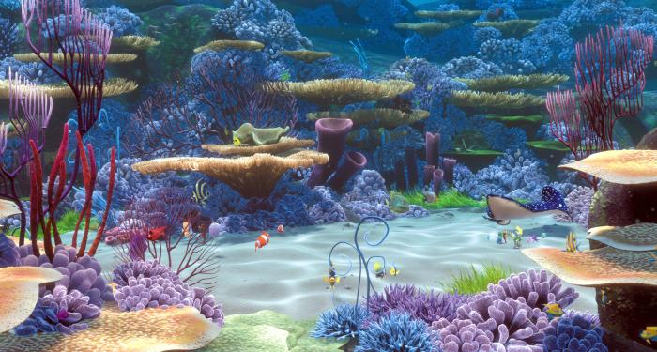

Implementing the end-to-end ecosystem model Atlantis on the Great Barrier Reef.
Marie Savina-Rolland, Roland Pitcher, Beth Fulton, Rebecca Gorton, Ian McLeod, Scott Condie
Wealth from Oceans

Slide 2
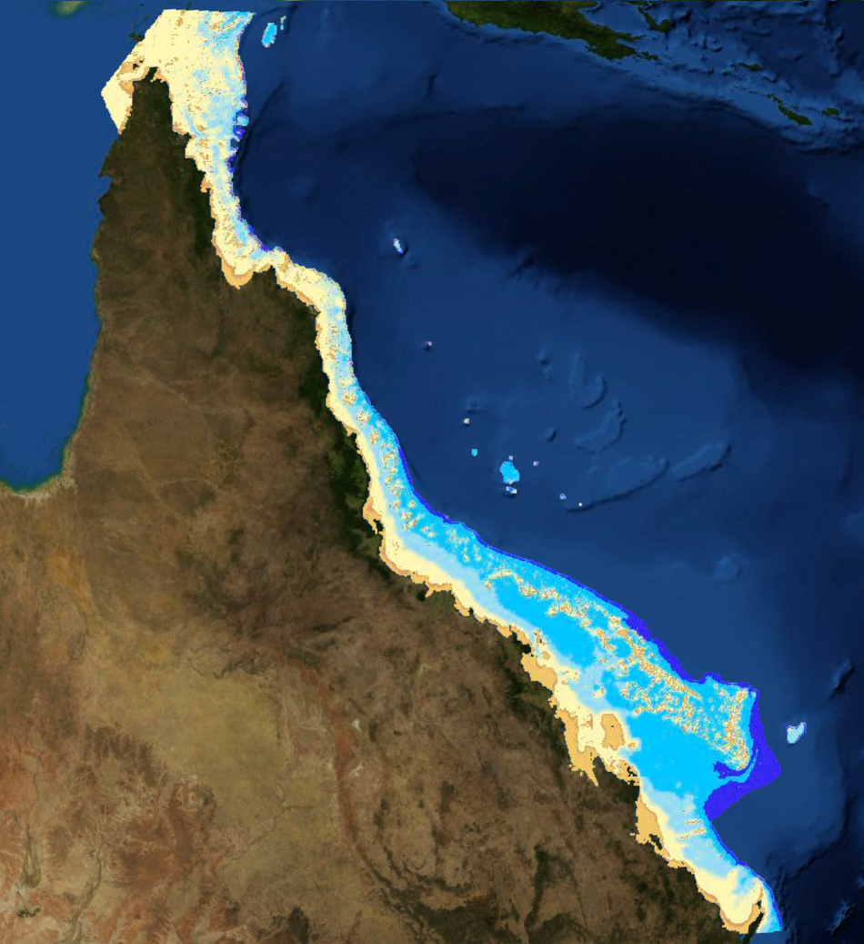
The Great Barrier Reef
Largest coral reef ecosystem
Biodiversity/ Habitats/ Species of interest
National significance
International significance

Slide 3
The Great Barrier Reef
Threats
Land use
Increasing sediment input
High inputs of nutrients
Pesticides
Uses
Commercial marine tourism
Fishing
Ports and shipping
Defence
Recreation ...
Climate change
sea level rise
potential changes in cyclone activity
increase in sea water temperature
increase in ocean acidity

Slide 4
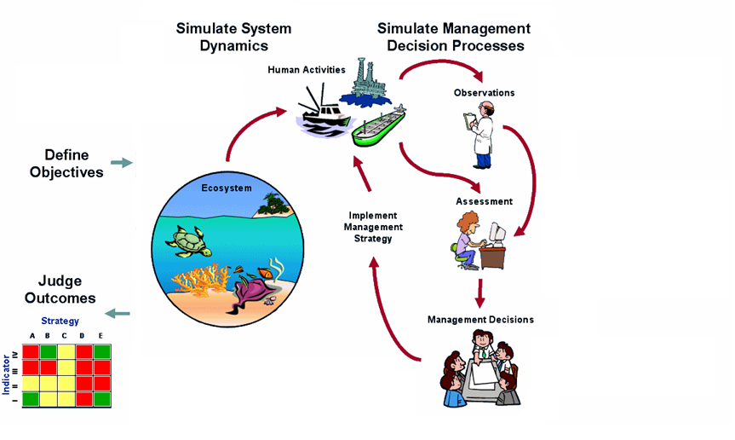
Atlantis

Slide 5
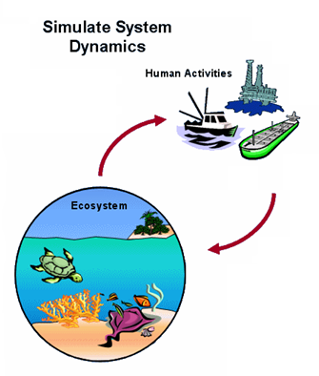
Atlantis
System understanding
sensitivity analysis
model complexity
What-if scenarios
river flows
fisheries
protected areas
...

Slide 6
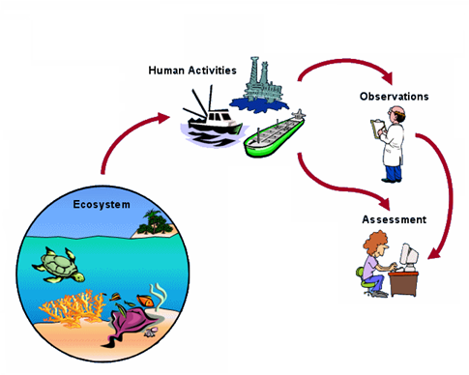
Atlantis
Sampling and monitoring strategies
Assessments

Slide 7
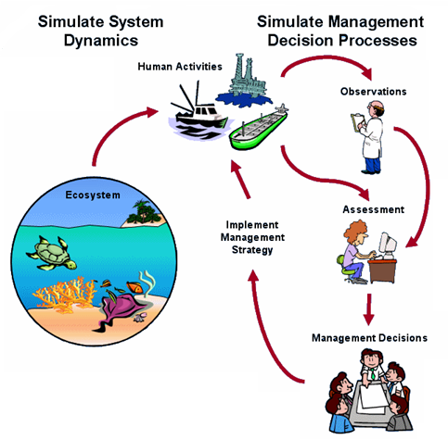
Atlantis
First stage

Slide 8
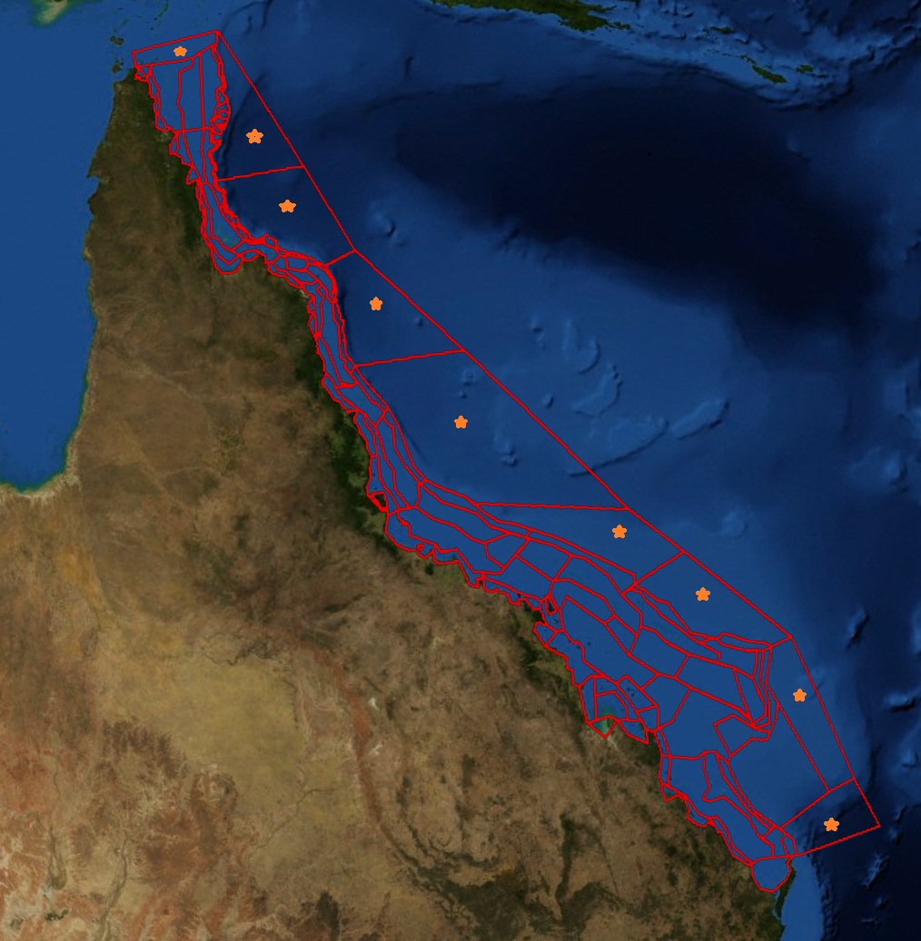
The Atlantis GBR
0
5
10
20
50
100
200
108 boxes
(9 boundary boxes)
Bathymetry
Benthic assemblages
(Pitcher et al, 2007)
IMCRA 4.0 provincial bioregions
Up to 6 vertical layers

Slide 9
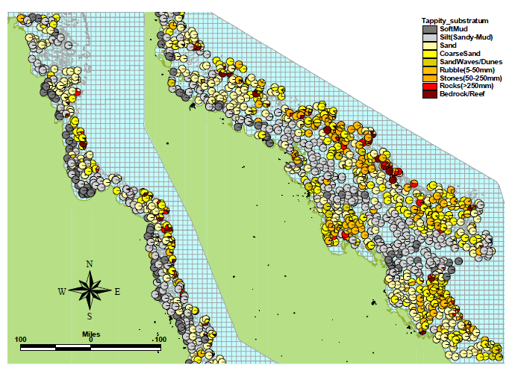
The Atlantis GBR
from Pitcher et al, 2007

Slide 10
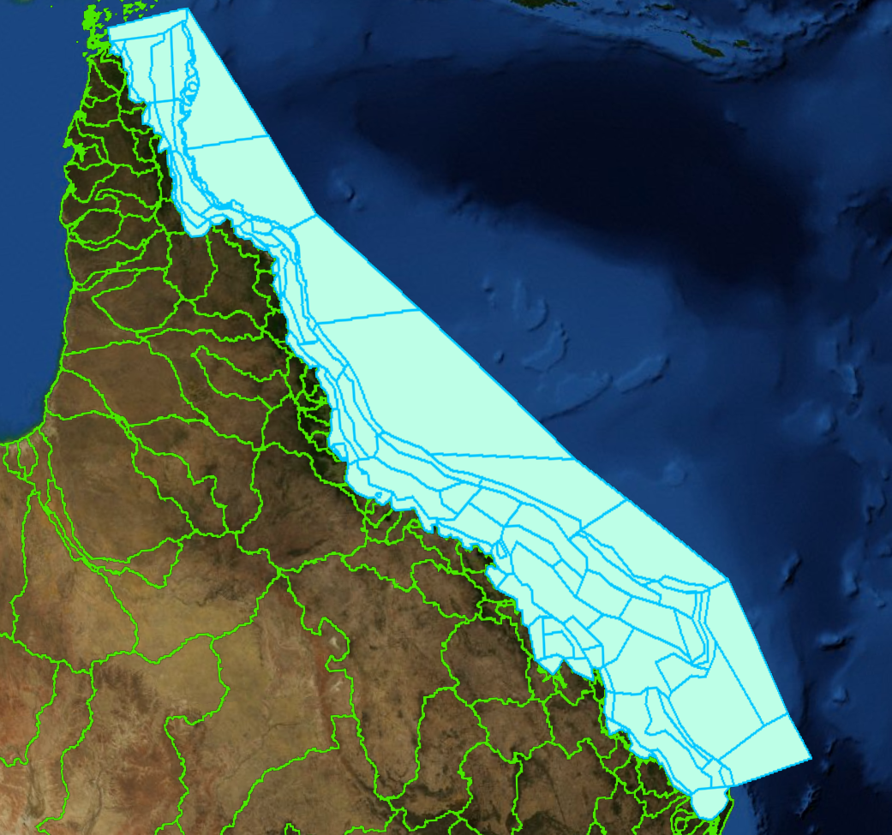
The Atlantis GBR
Forcings
transport 4km SHOC GBR
model (CMAR/AIMS)
9 boundary boxes: Tº, S,
nutrients, plankton
35 rivers: TSS, NH3,
NO3, DON, Tº
Irradiance

Slide 11
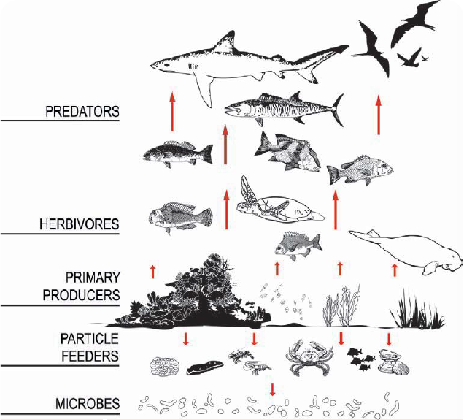
Deterministic
N currency
Age structured groups
(N and W– reproduction)
Biomass pools
Processes:
  Consumption
  Production
  Waste production
  Migration and other mvts
  Predation
  Reproduction
  Habitat dependency
  Fishing and other mortalities
Modularity
The Atlantis GBR
From the GBR outlook report 2009

Slide 12
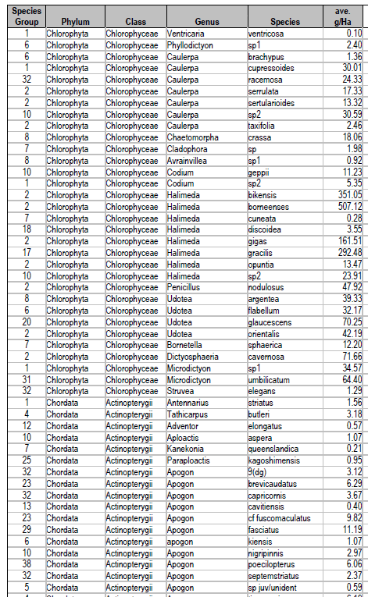
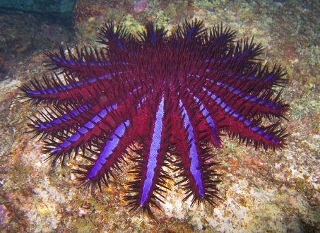
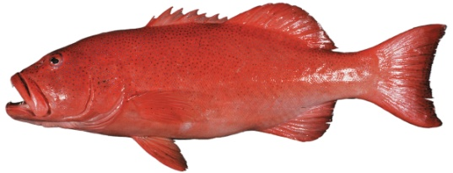
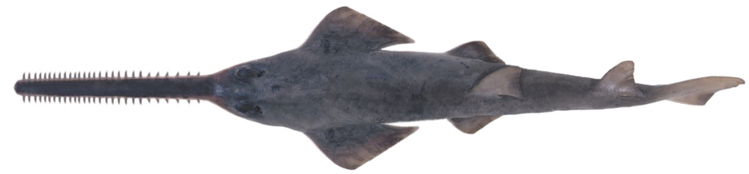
The Atlantis GBR

Slide 13
Perspectives
Functional groups
New functionalities (coral reefs – depth subscaling)
Parameterisation
Calibration

Slide 14

Thank you
CMAR
  Marie Savina-Rolland
    t +61 7 3833 5961
    e Marie.Savina-Rolland@csiro.au
CsIRO Marine and Atmospheric research

